Slide 1



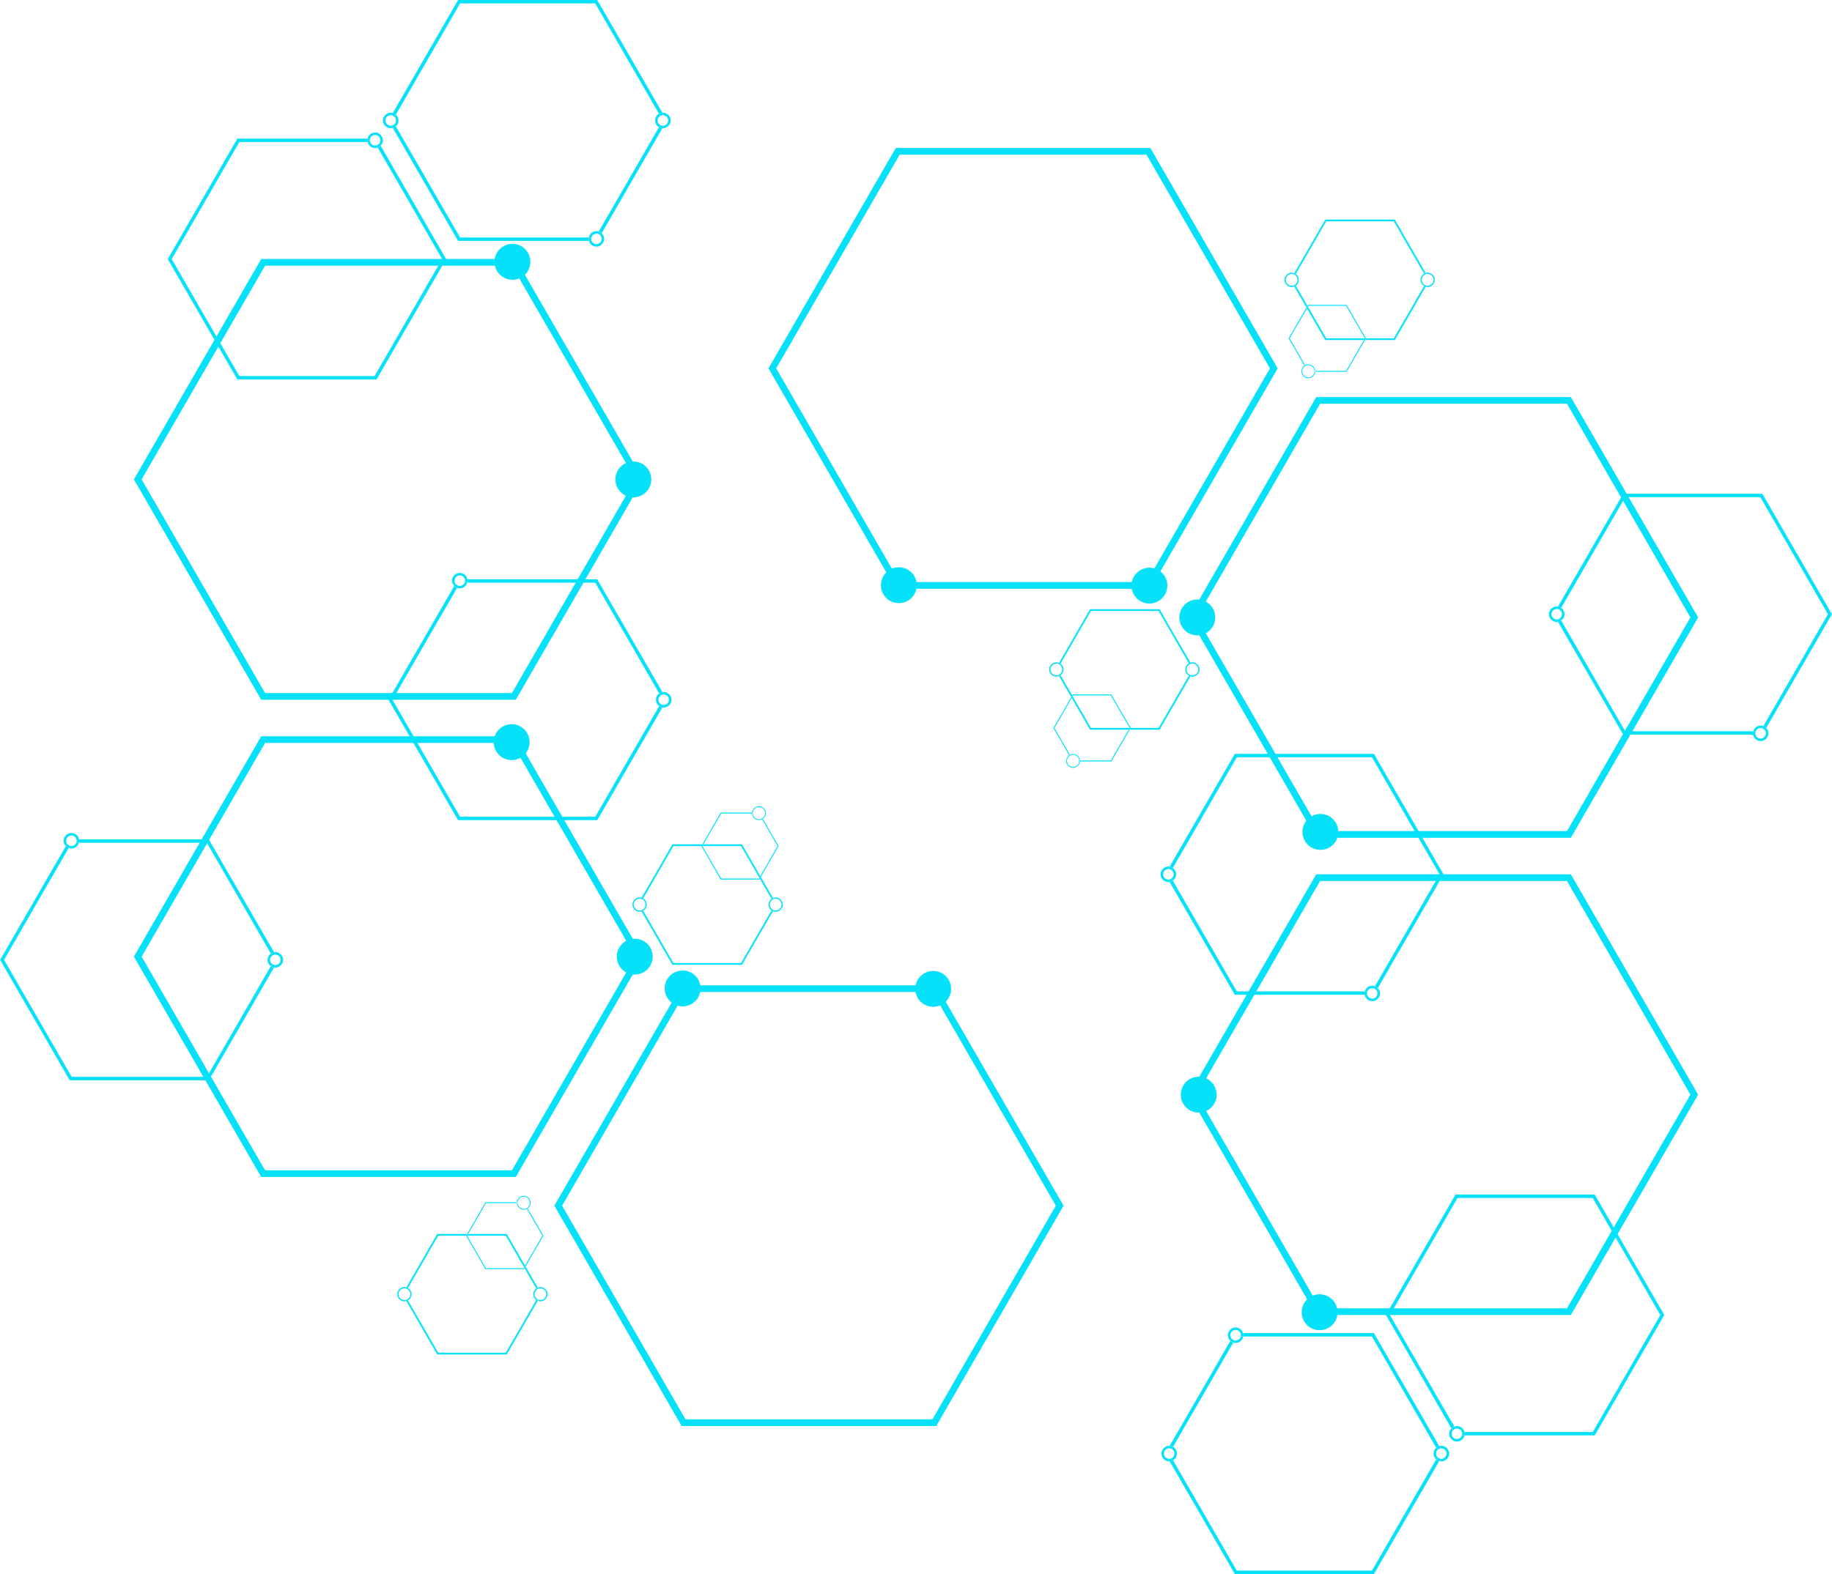
Faculty of Computer Science & Engineering
Ss. Cyril and Methodius University
Факултет за информатички науки и компјутерско инженерство (ФИНКИ)
Detecting Antisemitic Tweets Using NLP and Machine Learning
Presented By
Yonatan Sasson
Yuval Amir
Jacob Tordjman
Noam Azrad

Slide 2




Table of Contents
01
Overview
02
Problem Statement
03
Dataset Description
04
Preprocessing & Feature Engineering
05
ML Methods Used
06
Results
07
Conclusion

Slide 3

Project Overview
In this project, we built a machine learning model to identify antisemitic content in tweets. We experimented with different text preprocessing methods, sampling techniques, and model architectures to achieve the best performance.

Slide 4

Problem Statement
What is the problem?
With the continuous rise of activity on social media like X (formerly Twitter), antisemitism has surged online. People post hateful views from the safety of their homes, fueling harmful content.
Motivation:
As Jews, we strive to fight antisemitism, especially online, to reduce hateful expressions and protect individuals and communities from harm.
As computer science students, we have the skills to develop and implement technologies that combat hateful content, helping to create a safer online environment for everyone.
Hypothesis:
By using advanced NLP models (like RoBERTa), proper text cleaning,
and addressing class imbalance, we can achieve high accuracy and a
balanced recall/precision for the antisemitic class.

Slide 5
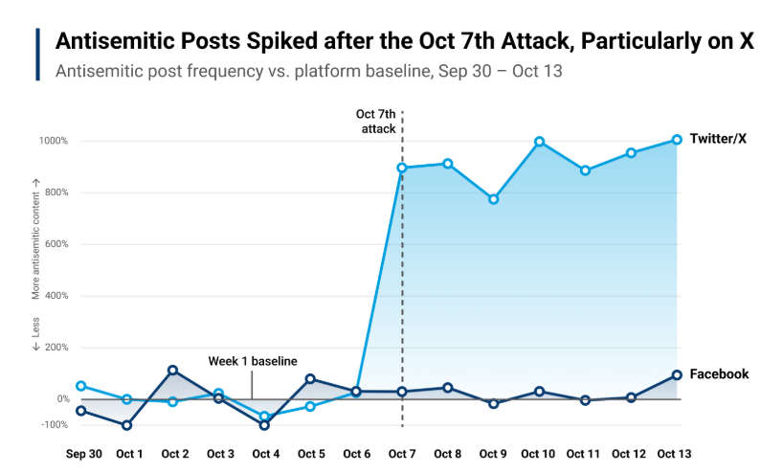


Example:
Researchers analyzed around 163,000 tweets around the initial Hamas attacks. They observed a 919% surge in antisemitic tweets on X (formerly Twitter)

Slide 6
Dataset Description
Data Source:
A CSV file (“tweets.csv”) with over 6,900 tweets, each labeled as “0” (non-antisemitic) or “1” (antisemitic).
Exploratory Analysis:
Original distribution: ~20% antisemitic, ~80% non-antisemitic.
Collected between 2019–2021.
Features/Columns:
Text: The raw tweet content.
Biased (label): The ground truth (0 or 1).
Target Variable:
label (0 or 1).

Slide 7
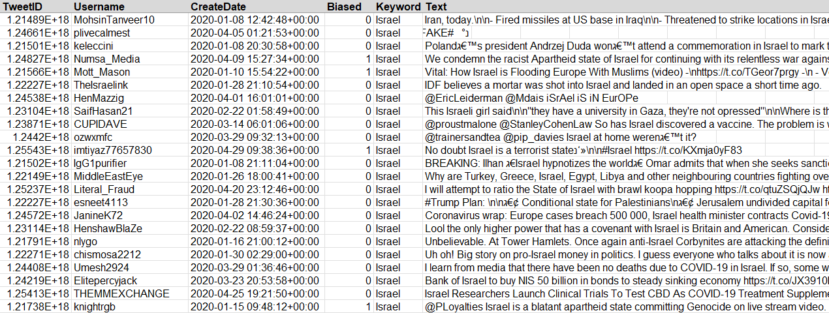

The data set:

Slide 8
Preprocessing & Feature Engineering
Preprocessing Steps:
Text Lowercasing: Convert all letters to lowercase.
Removing URLs and Digits: Eliminate links and numbers.
Removing Extra Spaces: Clean up whitespace.
Keeping Important Punctuation: We kept characters like “!”, “?”, and “.” to preserve some sentiment cues.
Why?
To reduce noise and standardize the input.
Punctuation can be relevant (e.g., repeated “!” might indicate stronger sentiment).
Feature Engineering:
We rely mostly on the RoBERTa tokenizer to transform the text into token IDs.

Slide 9
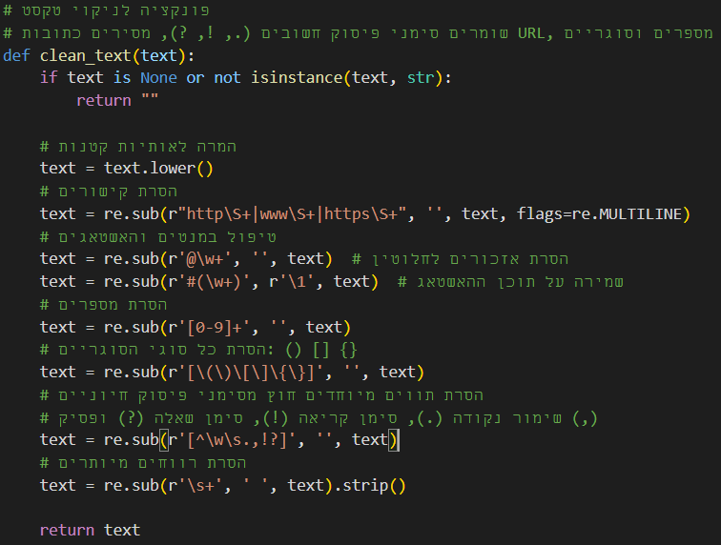

Clean text function
@RobertRLOCKLEA5 @dbongino @MittRomney @lisamurkowski @SenatorCollins Israel has been destroying Palestinians and stealing their land for DECADES. The USA is drilling oil in PALESTINE, thats theft! They are INVADING another country...Remember Poland?
robertrlocklea5 dbongino mittromney lisamurkowski senatorcollins israel has been destroying palestinians and stealing their land for decades. the usa is drilling oil in palestine thats theft! they are invading another country. remember poland?
Clean Text

Slide 10
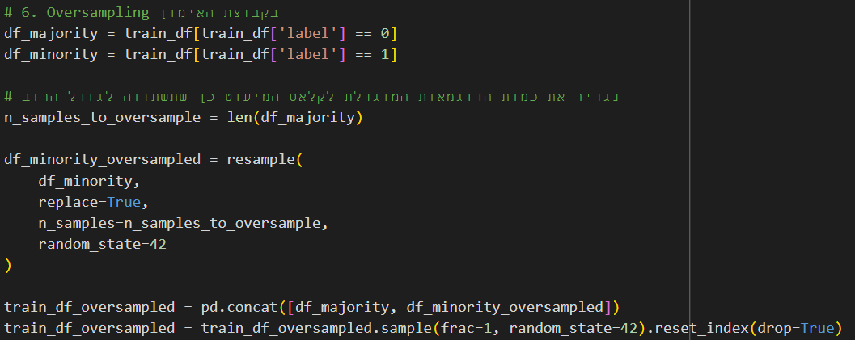
ML Methods Used
Initial Approaches:
Tried BERT (base-uncased) and RoBERTa-Large with different batch sizes (8, 16, 32, 64) and different text-cleaning rules.
Tested undersampling and oversampling to handle class imbalance.
Example of Over Sampling
Final Model:
RoBERTa-large fine-tuned on oversampled training data.
Batch size = 64, LR = 2e-5, 2 epochs.
Why RoBERTa-large?
Often outperforms basic BERT in many NLP tasks.
Sampling Approach:
Oversampling the minority class (label=1) to match the majority class.
This helped improve recall on antisemitic tweets.

Slide 11

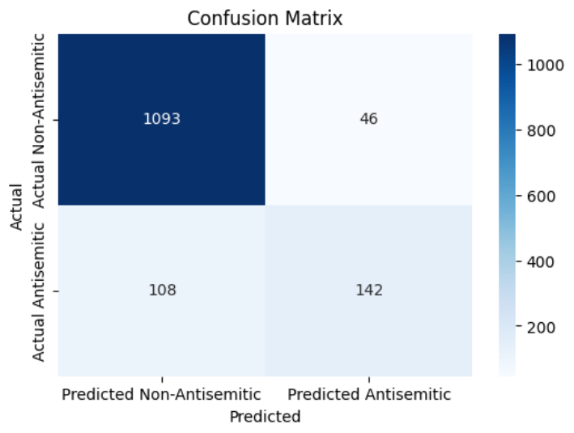
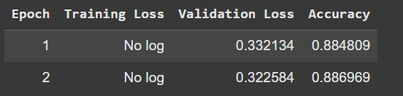


Workflow – Model V.1
Clean Text: Removes URLs, @mentions, hashtags, non-alphabetic characters, and extra whitespace, and converts text to lowercase.
Dataset: Uses the original dataset as-is (after cleaning) without performing oversampling or undersampling.
Model: Based on BERT-base
Batch Size: 16
Number of Epochs: 2
The confusion matrix shows the model classifies most non-antisemitic tweets correctly (1,093 correct vs. 46 misclassified) but misses some antisemitic tweets (108 misclassified).

Slide 12
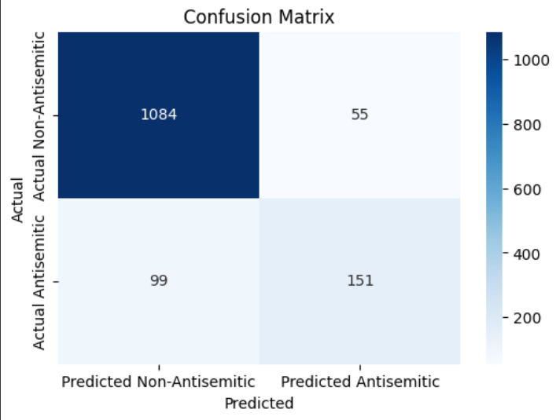
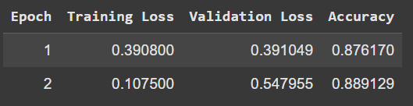
Workflow – Model V.2
Clean Text: Removes URLs, @mentions, hashtags, non-alphabetic characters, and extra whitespace, and converts text to lowercase.
Dataset - Oversampling: The minority class (label=1) is duplicated to match the majority class count.
Model: Based on BERT-base
Batch Size: 16
Number of Epochs: 2
The confusion matrix shows the model classifies most non-antisemitic tweets correctly (1,084 correct vs. 55 misclassified) but misses some antisemitic tweets (99 misclassified).

Slide 13
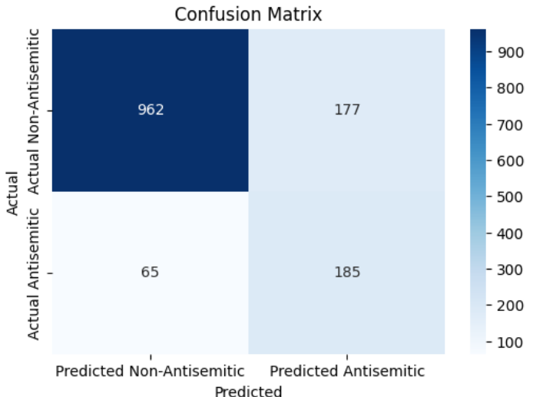
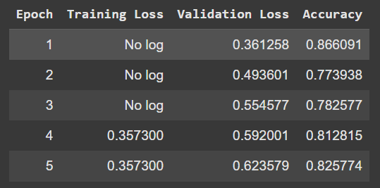
Workflow – Model V.3
Clean Text: Removes URLs, @mentions, hashtags, non-alphabetic characters, and extra whitespace, and converts text to lowercase.
Dataset - Under-Sampling: Caps both classes at 1,200 examples in the training set.
Model: Based on BERT-base
Batch Size: 16
Number of Epochs: 5
The confusion matrix shows the model classifies non-antisemitic tweets correctly (962 correct vs. 177 misclassified) but misses some antisemitic tweets (65 misclassified).

Slide 14
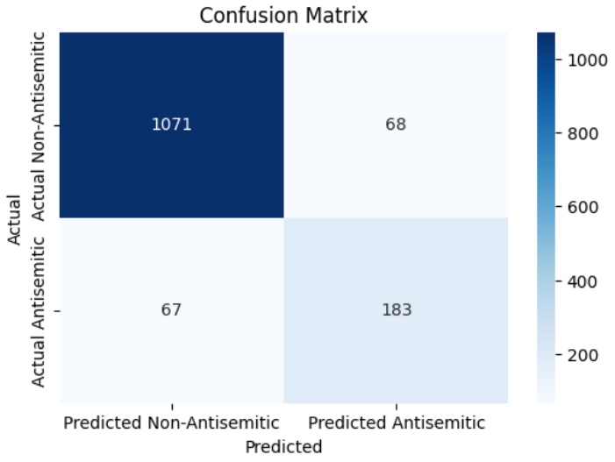
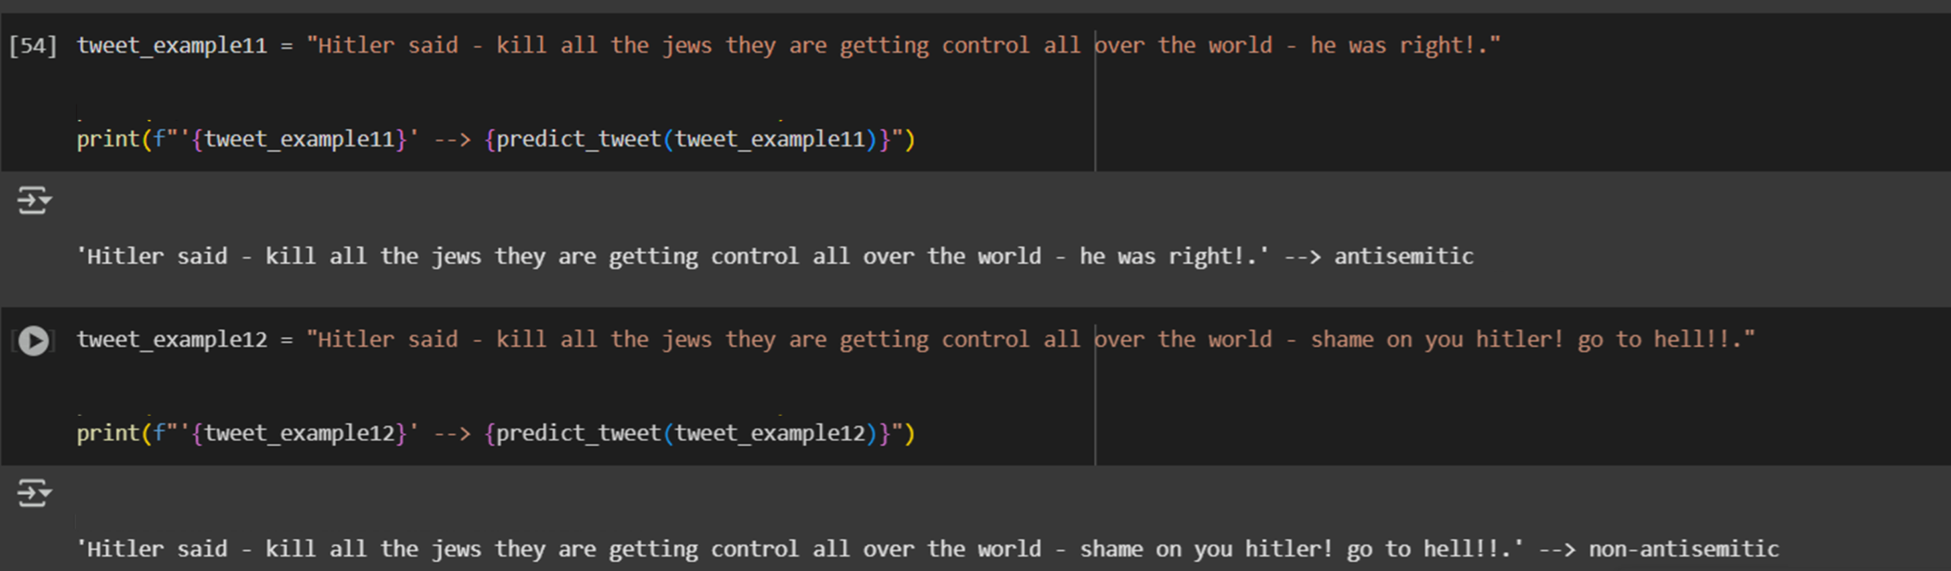
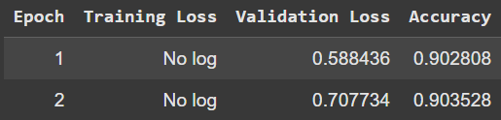
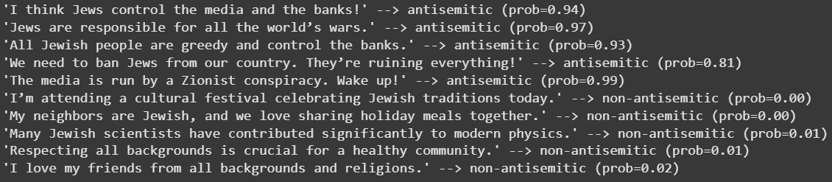
Workflow – Model V.4 Final Version
Clean Text: Converts text to lowercase, removes URLs and numbers, and reduces extra whitespace while preserving punctuation.
Dataset - Oversampling: The minority class (label=1) is duplicated to match the majority class count.
Model: Based on RoBERTa Large
Batch Size: 64
Number of Epochs: 2
The confusion matrix shows the model classifies non-antisemitic tweets correctly (1071 correct vs. 68 misclassified) but misses some antisemitic tweets (67 misclassified).

Slide 15
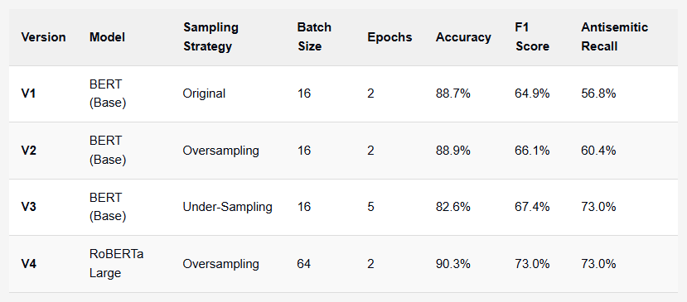
Results
46
108
55
99
177
65
Miss Non
Miss anti
Miss Non
Miss anti
Miss Non
Miss anti
Key Metrics:
Model Configuration Comparison
Accuracy: Overall correctness of classification.
Precision & Recall for the antisemitic class.
F1 (harmonic mean of precision and recall).
v1
v2
v3
Final Model Performance (Test Set):
68
127
53
76
Accuracy: 90.3%
Precision (antisemitic): ~76%
Recall (antisemitic): 73%
F1 (antisemitic): 73%
Miss Non
Miss anti
Miss Non
Miss anti
Observations:
v4
v5
Oversampling + RoBERTa-large improved recall significantly compared to baseline.
Batch size – 64.

Slide 16


Conclusion
Hypothesis Outcome:
Using advanced NLP models (RoBERTa) with careful preprocessing and addressing class imbalance indeed boosted performance.
Key Takeaways:
Oversampling effectively balanced the dataset, improving recall for the minority class.
Fine-tuning hyperparameters (mainly batch size).
Keeping punctuation and chars like ‘?’, ‘!’ can help for better results.
Future Work:
Collect more varied antisemitic examples to cover slang, code words, etc.
Experiment with data augmentation (e.g., back-translation).

Slide 17

Thank You

